Slide 1
Digital Portfolio
STUDENT NAME : K.PRIYA
REGISTERE NO AND NMID: 3BA6DFD705683E4A2CD49C71370F0E74
DEPARTMENT : B.SC (CS)
COLLEGE: SHIRI KUMARAN COLLEGE OF ARTS AND SCIENCE (BHARATHIYAR UNIVERSITY)

Slide 2
PROJECT TITLE
Student digital portfolio

Slide 3
AGENDA
1. Problem Statement
2. Project Overview
3. End Users
4. Tools and Technologies
5. Portfolio design and Layout
6. Features and Functionality
7. Results and Screenshots
8. Conclusion
9. Github Link

Slide 4
PROBLEM STATEMENT
☆ Project-based learning, or PBL, is an instructional approach that encourages students to explore real-world problems and challenges. It is an engaging and meaningful way for students to learn, allowing them to apply their knowledge in a practical context.

Slide 5
PROJECT OVERVIEW
1.Brief Summary Project:
My digital portfolio is a collection of my academic achievements, creative work, skills, and experiences. It represents my growth as a student and showcases my talents in various fields. This portfolio highlights my learning journey, Projects, extracurricular activities, and personal reflections. It serves as evidence of my dedication, creativity, and continuous improvement, while also preparing me for future opportunities in higher education and career paths.

Slide 6
2. PORTFOLIO CONTAINS:
☆ My Self
☆ Skills
○ Hard Skills
○ Soft Skills
☆ Hobbies
☆ Language
☆ Certificate
☆ Contact

Slide 7
3.Main Idea:
☆ This project was created to enhance my knowledge and apply the concepts I have learned. It helped me develop problem- solving skills creativity, and teamwork. The project reflects my dedication, effort, and interest in exploring new ideas.

Slide 8
WHO ARE THE END USERS?
1.Students Use:
Project Title:[Student Digital Portfolio]
Description:
This project was carried out as part of my with academic curriculum. It provide me with practical exposure and helped me apply theoretical concepts to real-life situations. Through this project, I gained knowledge in research, problem-solving, and technical skills, which will support my future academic and career goals.

Slide 9
2. Job Seeker's Portfolio:
☆ I am enthusiastic and dedicated job seeker looking for opportunities to contribute my skills and knowledge in a professional environment. I am eager to learn, adaptable to new challenges, and committed to delivering quickly results. My goal is to grow both personally and professionally while adding value to the organisation I work with.

Slide 10
3. Freelances:
☆ I work with commitment to deliver high-quality results on time and tailored to client needs. My focus is on creativity, professionalism, and building long-term client relationships.

Slide 11
TOOLS AND TECHNOLOGIES
1.HTML:
HTML stands for Hyper Texts Markup Language used to create and design Web pages. HTML structures the content of a Webpage using elements like headings, paragraphs, images, links, and tables. It is the backbone of all websites and works together with CSS and JavaScript to build complete Web applications.

Slide 12
2. CSS
☆ CSS stands for Cascading Style Sheets. It is used to style and design Web pages. While HTML gives structure to Webpage, CSS controls how it looks –such as colours, fonts, layouts, spacing, and responsiveness. CSS makes websites more attractive, user –friendly, and visually appealing.

Slide 13
3. JavaScript:
JavaScript is a programming language used to make Web pages interactive and dynamic. While HTML provides structure and CSS handles design, JavaScript adds functionality-such as form validation, animations, image sliders, pop-up messages, and interactive buttons. It is widely used in Web development to create responsive and user-friendly websites and applications.

Slide 14
PORTFOLIO DESIGN AND LAYOUT:
☆Sections Included:
•Home
▪︎ My Self
▪︎ Hobbies
▪︎ Certificate
☆ Skills:
• Hard Skills
• Soft Skills
☆ Contact:
• Email
• Address
• Contact Number

Slide 15
FEATURES AND FUNCTIONALITY
☆ Navigation bar with smooth scrolling.
☆ Project showcase with images/details.
☆ Interactive elements(hover effects, animations).
☆ Contact form(with validation).
☆ Responsive design for all devices.

Slide 16
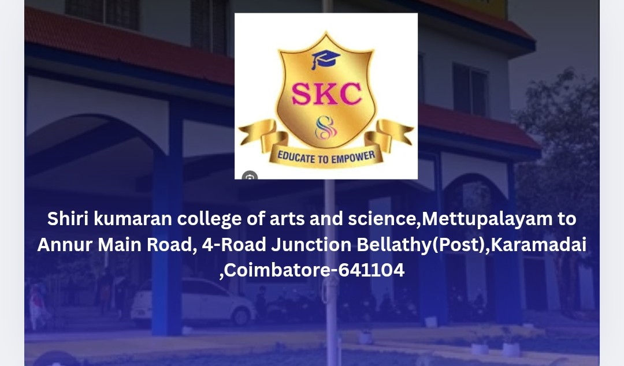
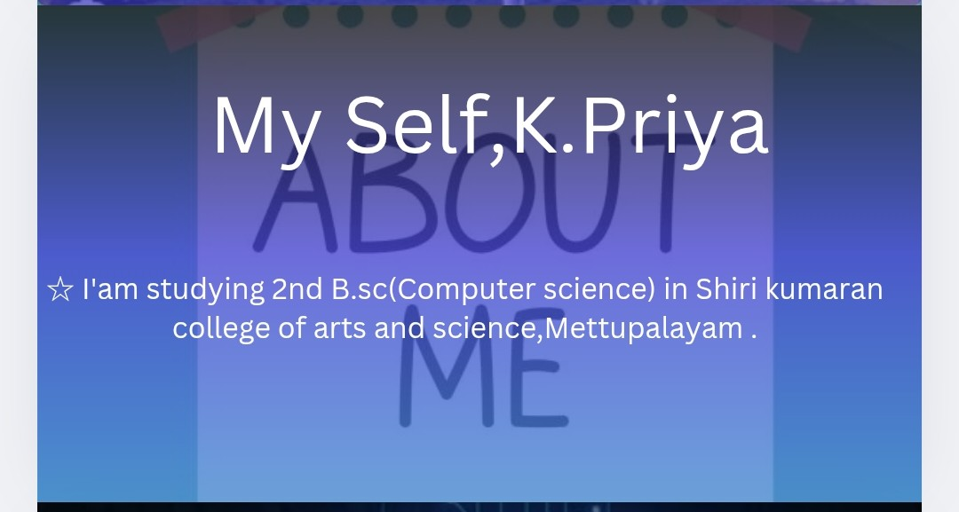
RESULTS AND SCREENSHOTS:

Slide 17
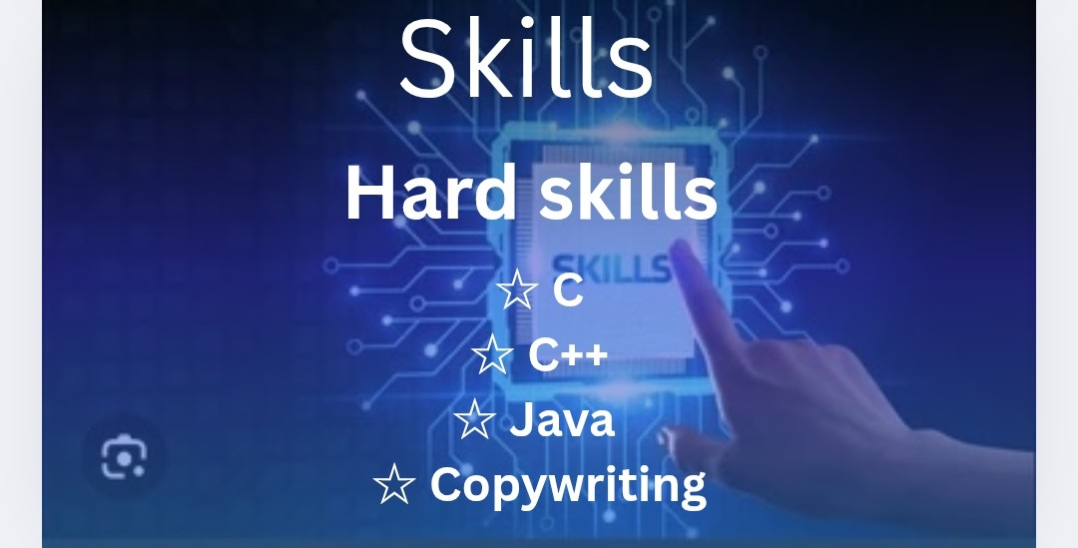
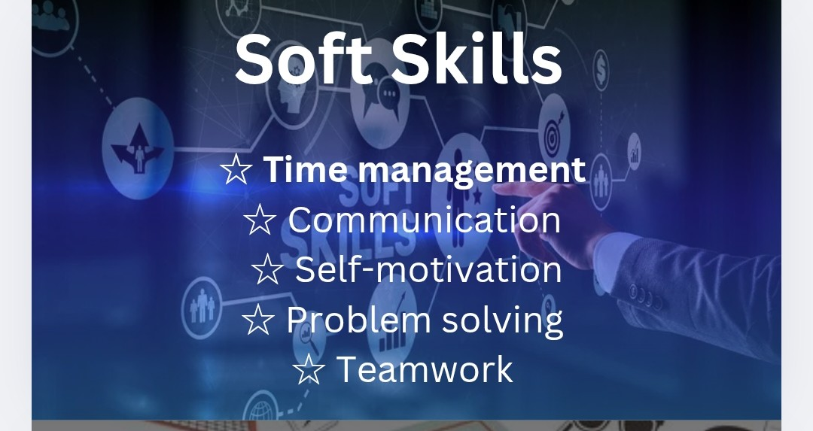

Slide 18
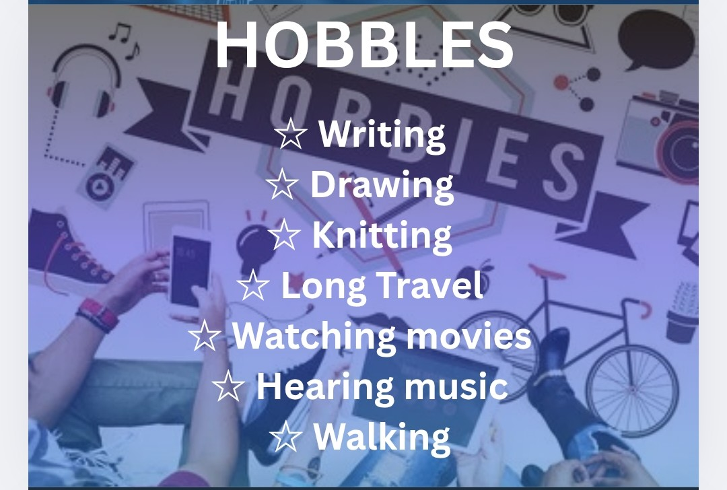


Slide 19
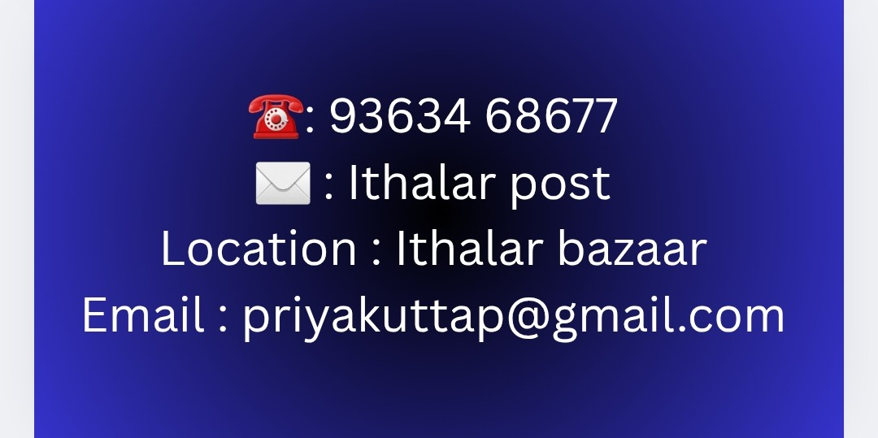

Slide 20
CONCLUSION:
☆ Highlights of project:
1. Clear project objectives and well-defined goals.
2. Practical application of theoretical knowledge.
3. Innovative ideas and creative problem-solving.
4. Use of modern tools, techniques, and technology.
5. Teamwork, time management, and communication skills.
6. Achievement, results, and overall impact.

Slide 21
Final Summary:
☆ This project has been a valuable learning experience that enhanced my knowledge, skills, and creativity. It helped me apply theoretical concepts in practical ways and strengthened my problem-solving and teamwork abilities. Overall, the project reflects my dedication, hard work, and interest in continuous and professional growth.

Slide 22
Benefits to society:
☆ This project contributes positively to society by providing practical solutions and spreading awareness. It is designed to improve knowledge, promote innovation, and create value that can help people in their daily lives. The project reflects social responsibility and aims to make a meaningful impact on the community.

